Slide 1
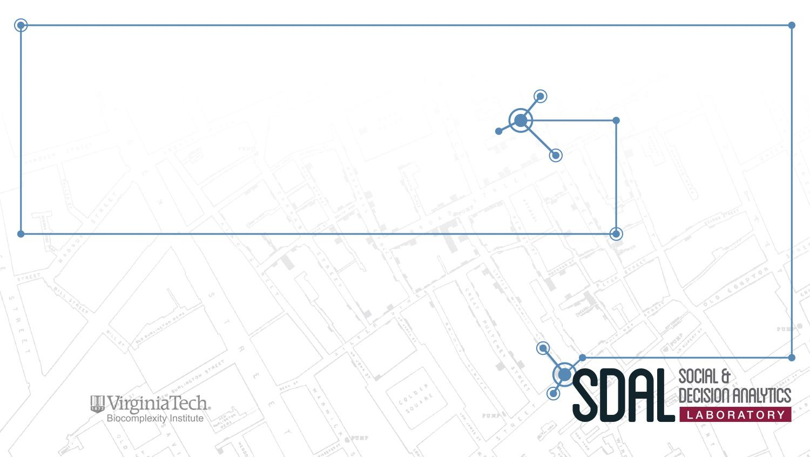
DSPG 2018 Project Descriptions

Slide 2
Projects
New Metrics for Assessing Virginia Tech Student Acquisition, Progression & Success VT Office of the Executive Vice President and Provost
National-Level Projects
National Science Foundation (NSF):
Measuring the Scope and Impact of Open Source Software Innovation
Measuring Business Innovation Using Non-Traditional Data Sources
Identifying STEM Pathways
Army Research Institute (ARI): Community Embeddedness of Army Soldiers
Local Community Projects
ACPD - Alcohol-Related Crime Reduction Strategies for Restaurants and Nightlife in Arlington
DHS - Data Linkage & Characterization Phase II, Department of Human Services
CPN - Arlington Equity Composite Indicators, Community Progress Network
Roanoke - Create Community-Scapes for City of Roanoke and Allegheny Valley Regions in Virginia
State-Level Projects
VCE - New Data Sources for Virginia Cooperative Extension Community Profiles
VDSS - Fitness of VDSS Administrative Data Sources
UMFS - Foster Parent Recruitment and Disruptions in Foster Care

Slide 3
New Metrics for Assessing Virginia Tech Student Acquisition, Progression & Success
PI: Aaron Schroeder
Team: Gizem Korkmaz and Sallie Keller
Sponsor: Ken Smith, Virginia Tech Office of the Executive Vice President and Provost

Slide 4

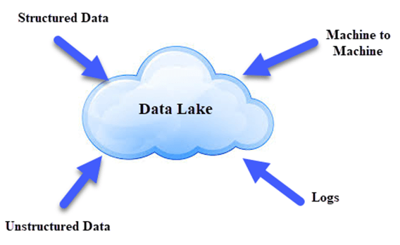
Project Overview
Virginia Tech has operated over the past few decades through a data warehouse enterprise systems architecture
Purpose-oriented and traditionally siloed (including HR, Finance, Facilities, Space, and Donors)
Virginia Tech currently has an initiative to establish a “data lake” architecture allowing for the extraction and cross-system analysis of data from these separate enterprise systems
Using “data lake” plus others data we discover, VT wants to build a new set of metrics to gain a better understanding in a number of strategic areas including Student Acquisition, Student Progression & Student Post-Graduation Success

Slide 5
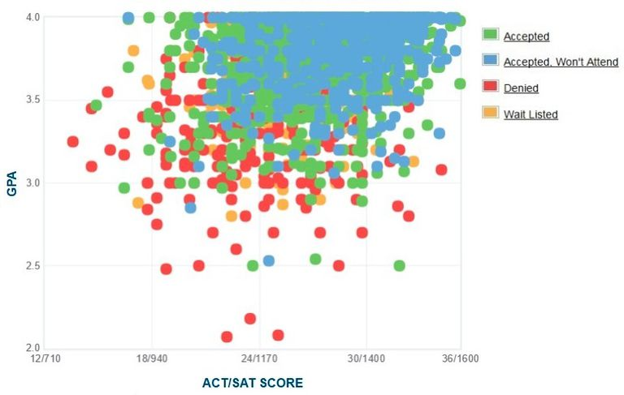
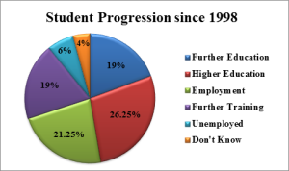
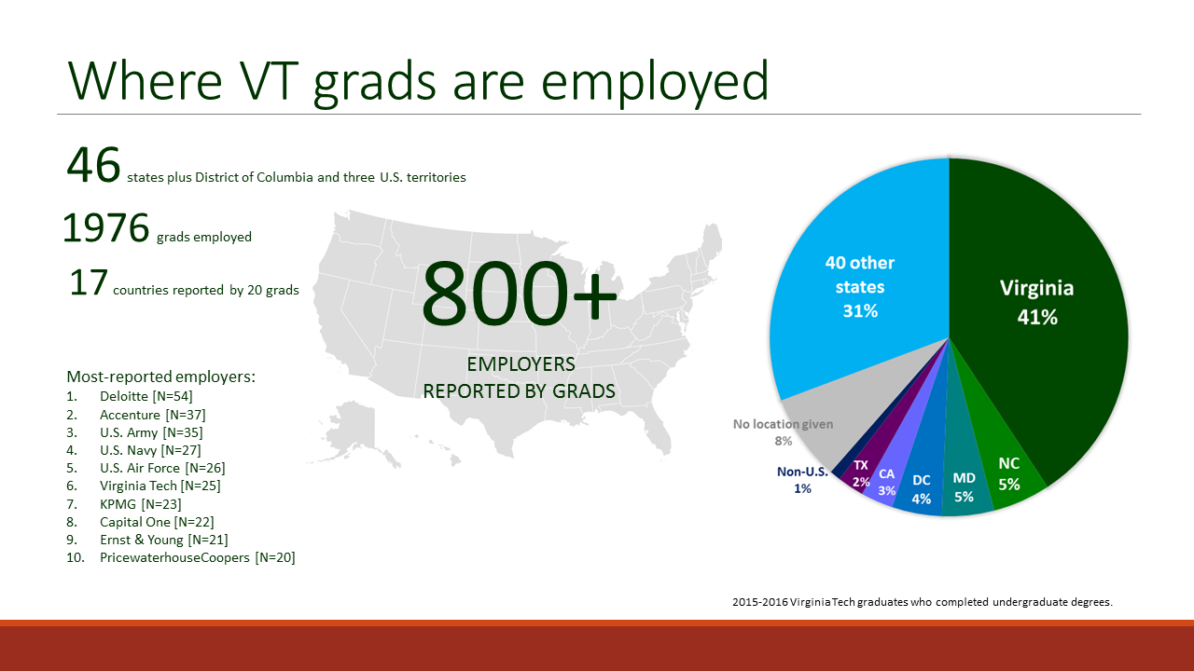
Project Goal(s) / Research Questions
Use the new Virginia Tech Data Lake and other available external data, to assess the potential to create new metrics to measure student success in the areas of:
Admissions/Acquisition: VT currently knows a lot about students who choose to attend, but would like to know about students who were accepted but choose to attend elsewhere. Are they going up or down market?
Student Progression/Success: Are VT students on predicted trajectory towards their degrees? Are they graduating on time?
Post-Graduation Success: VT currently conducts a survey approximately 6 months after graduation to determine whether a student is employed, in graduate school, or doing something else? The response rate is currently 50-60% - is there a different way to get a higher percentage?
From this assessment, one or two new metrics of student success will be chosen, developed, and analyzed.

Slide 6
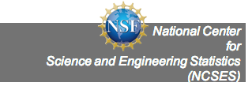

NSF National Center for Science and Engineering Statistics (NCSES) is responsible for the collection, interpretation, analysis, and dissemination of objective data on the science and engineering enterprise. They are responsible for statistical data on:
Research and Development (R&D), and Innovation
The science and engineering workforce
U.S. competitiveness in science, engineering, technology, and R&D
The condition and progress of STEM education in the United States
Notes:
Our mission at NCSES : a primary statistical agency, about 50 people Survey programs, Human Resources Statistics, and R&D Statistics, as well as two congressionally mandated reports on Science and Engineering.
How we do it:
Biennial report on the state of S&E in the U.S.
Required by law; delivered to the President and Congress
Factual and policy neutral
Drawn from a wide variety of high quality data sources
Produced by NCSES on behalf of the NSB

Slide 7

Measuring the Impact and Scope of Open Source Software Innovation
PI: Gizem Korkmaz
Team: Daniel Chen, Ian Crandell, and Stephanie Shipp
Sponsor: Carol Robbins, National Science Foundation (NSF) National Center for Science and Engineering Statistics (NCSES)

Slide 8
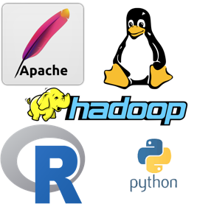
Project Overview
Current NCSES and other economic indicators do not measure the value of open source software outside the business sector:
Contribution of people from universities, government research institutions, nonprofits, and individuals
Importance of quantifying coding impact in the scientific community
Citations are used to measure the impact of patents and publications which are most frequently used to estimate the research outputs of universities and government institutions.
The goal is to test the feasibility and to develop methods to measure the impact and scope of open source software
Notes:
i.e., they are not captured in surveys nor are in economics measures such as the Gross Domestic Product (GDP).

Slide 9
Research Questions
How much open source software is in use? (stock measure)
How much is created each year? (flow measure)
What types can be identified?
Who creates it? (Sectors: Business, Government, Academia, Households, Nonprofits, Foreign)
What sources of data and variables could serve as proxies for measuring attributes and economic value of open source software?
Counts of OSS, by sector (e.g., university, government), by technology
Attributes, e.g., # citations, #downloaded, languages, etc.

Slide 10
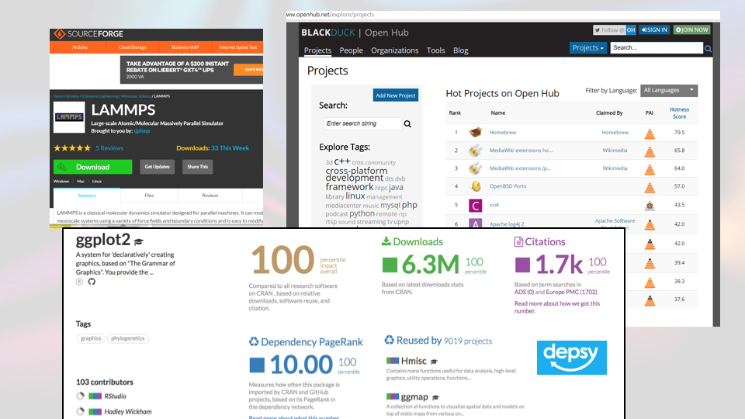
Data Sources
Notes:
Current and comprehensive survey data do not exist for the contributions of OSS, however, as OSS is disseminated online, a wealth of information is available to be scraped, both metadata and information embedded in repositories and in the code and headers of the software programs themselves. Our contribution is to show how these data can be used to develop measures of open source software that are complementary to GDP measures of private investment, shedding light on impact of open source software innovation currently not well understood.

Slide 11
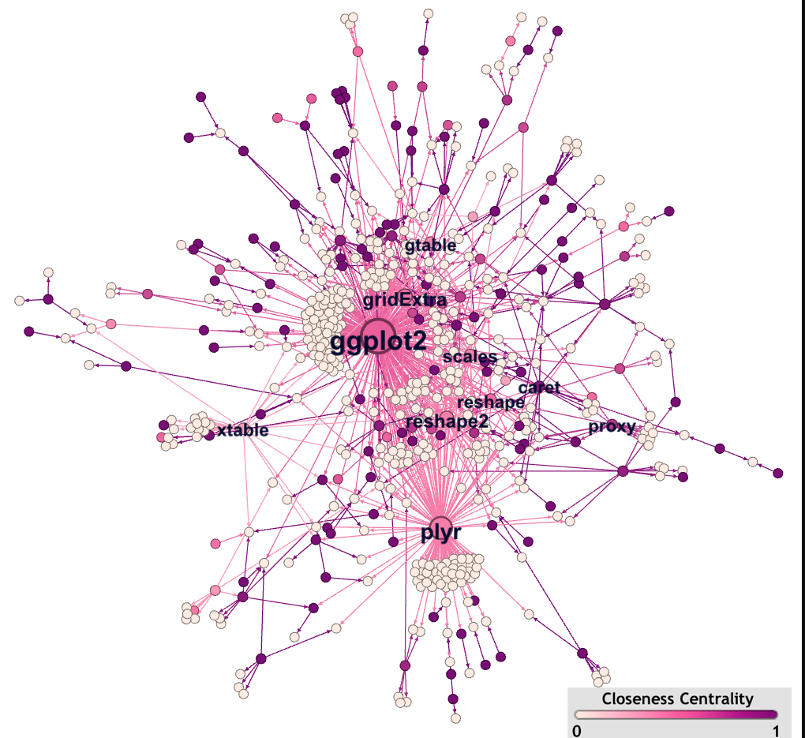
Project Goals & Deliverables
Building on research conducted since 2016
Understanding existing cost/value models for private software
Adapting to open source software
Data collection (webscraping)
code.gov & GitHub
CRAN
Modeling and network analysis

Slide 12
Measuring Business Innovation Using Non-Traditional Data Sources
PI: Gizem Korkmaz
SDAL Team: Ian Crandell, Bianica Pires, and Stephanie Shipp
DSPG Team: Fangfang Lee, Eirik Iversen (and Bayoan Santiago)
Sponsor: Gary Anderson, National Science Foundation (NSF) National Center for Science and Engineering Statistics (NCSES)

Slide 13
Project Overview
This project aims to test the feasibility of developing innovation metrics using non-traditional data sources including product announcements, press releases, and other information obtained through web scraping or queries of selected companies.
How can opportunity and administrative data be leveraged? What information could be obtained using non-traditional data sources? What methods and models are needed to adapt
Current practice to measure business innovation is to survey a sample of companies.(e.g., Business R&D and Innovation Survey(BRDIS)).
How can this approach complement the survey?
Notes:
i.e., they are not captured in surveys nor are in economics measures such as the Gross Domestic Product (GDP).

Slide 14
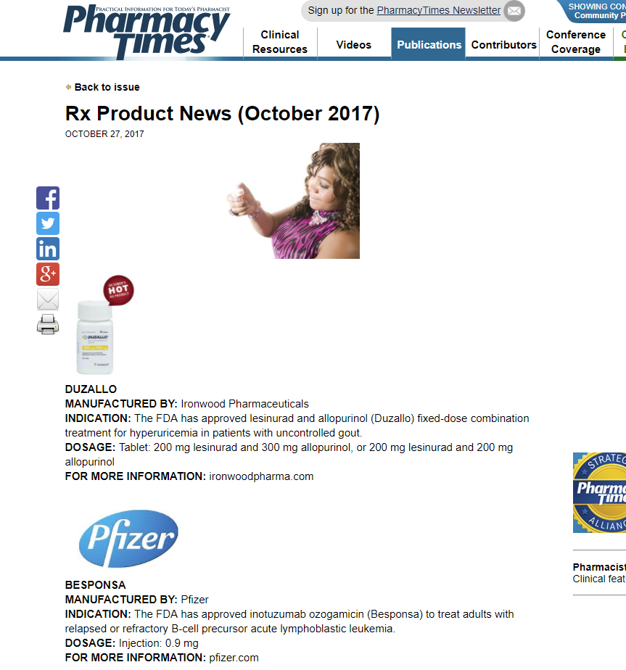
Current Focus
Is it possible to reliably identify the incidence of product innovation in particular industries, along lines of Oslo Manual definition.
How does it vary in different industries/sectors?
Pharmaceutical industry: drugs and medical devices
Scientific R&D and Technology
Which data sources will allow us to quantify more accurately the number and types of new products being introduced? (an innovation metric)
FDA.gov
SEC Filings
Trade Journals
Databases: Proquest, Techcrunch, and others

Slide 15
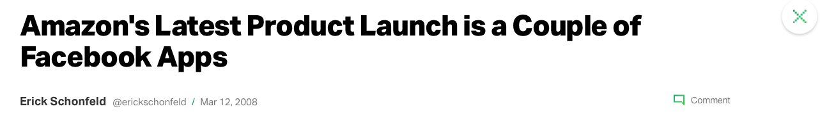
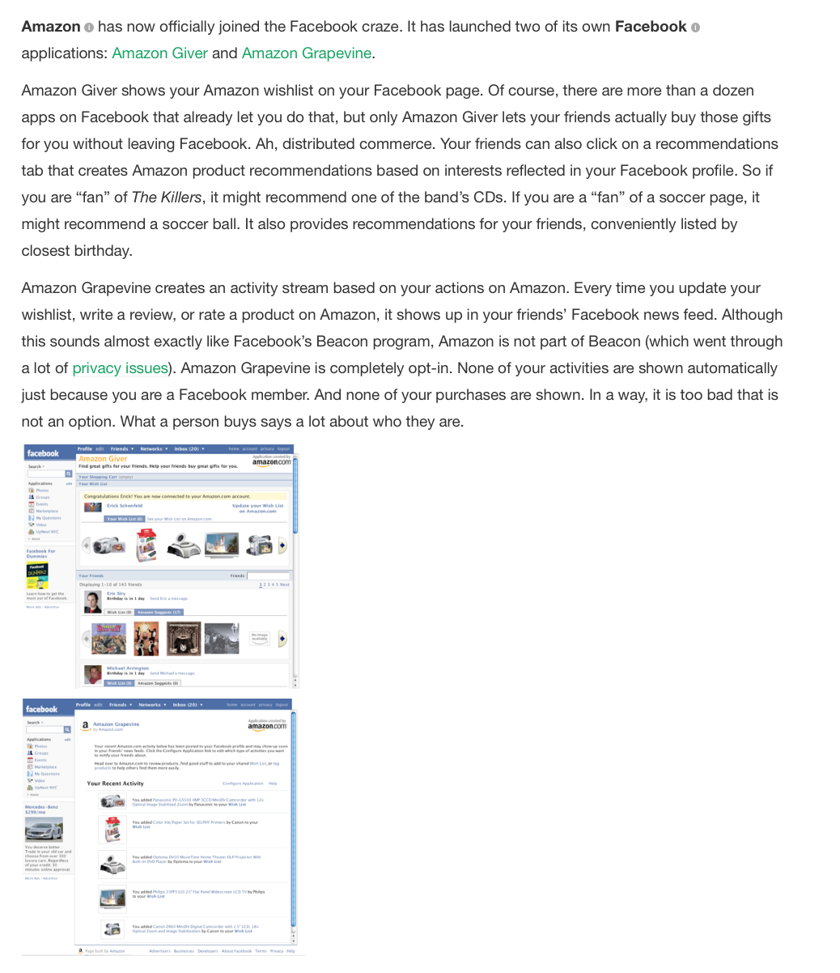
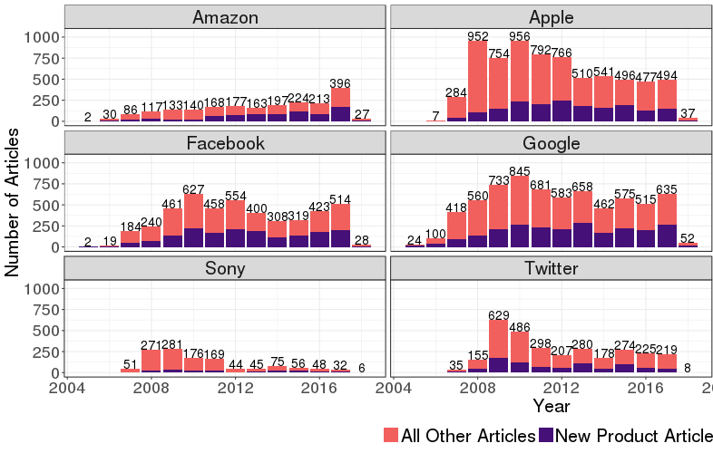
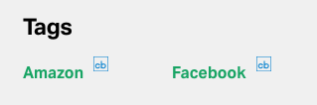
Project Goals & Deliverables
Webscraping trade journals
Text-labeling to develop algorithms
Text-mining to identify counts by product and company
Data source comparisons
Notes:
Our mission at NCSES : a primary statistical agency, about 50 people Survey programs, Human Resources Statistics, and R&D Statistics, as well as two congressionally mandated reports on Science and Engineering.
How we do it:
Biennial report on the state of S&E in the U.S.
Required by law; delivered to the President and Congress
Factual and policy neutral
Drawn from a wide variety of high quality data sources
Produced by NCSES on behalf of the NSB

Slide 16
Identifying Science, Technology, Engineering, and Mathematics (STEM) Pathways
PI: Bianica Pires
Team: Ian Crandell, Sallie Keller
Sponsor: Karen Hamrick, National Center for Science and Engineering Statistics (NCSES)

Slide 17
Project Overview
Problem Statement: Identify and measure education and training pathways to STEM-enabled occupations
NCSES relies on surveys to understand the landscape of STEM graduates and the STEM workforce.
Current NCSES reporting focuses on the ‘traditional’ pipeline of STEM education and training from high school to STEM occupation (e.g., National Survey of College Graduates, Survey of Earned Doctorates)
Half of all STEM jobs are available to workers without a 4-year degree and the pathways that lead to these jobs are diverse.
Notes:
STEM fields include computer science, engineering, math and statistics, as well as psychology and the social sciences

Slide 18
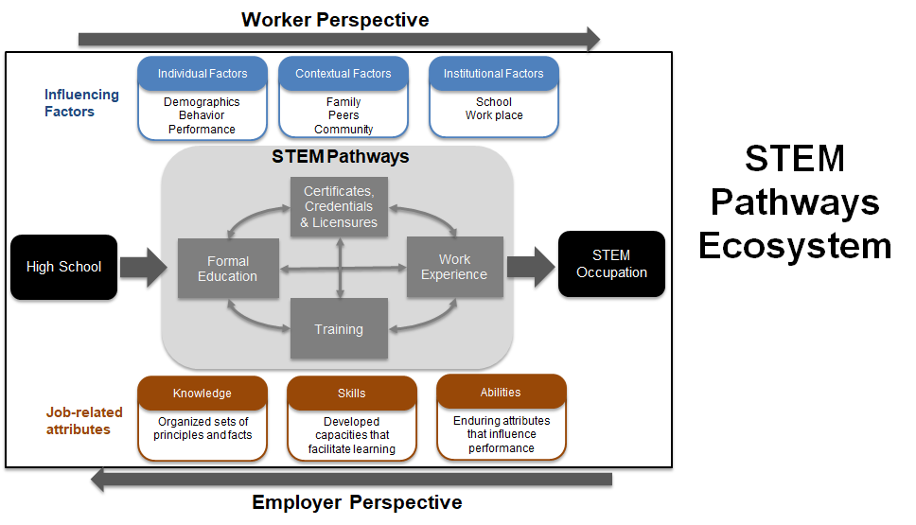

Slide 19
Research Questions
What are the knowledge, skills, and abilities gained through STEM pathways and how do they align to employer expectations?
What are the high school to workforce pathways that lead to a STEM-enabled occupation?
Focus on high school to post-secondary and workforce pathways in Virginia
Notes:
How do STEM professionals represent themselves? (e.g., when an individual calls himself or herself a Data Scientist, what STEM education, training, and skill sets does that represent?)
How do employers represent their skill set needs?
Is it possible to quantify a job improvement through promotion?
Do non-survey data sources exist to measure STEM pathways, e.g., scraping websites, administrative data, other.
Are there untapped surveys that exist to measure STEM pathways?, e.g. IPEDs?

Slide 20
Project Expectations
(Weeks 1-2) Background readings and write-ups
(Weeks 3-4) The landscape of non-traditional pathway possibilities: Data discovery, inventory, and acquisition of certificates/credentials, MOOCs, vocational schools, community colleges, etc.
(Weeks 5-10) Data exploration, analysis, and modeling
Profiling, exploring, and analyzing data related to non-traditional pathways
High-school level predictive models and postsecondary-going culture indicator

Slide 21
Community Embeddedness of Army Soldiers
Lead: Josh Goldstein
Team: Stephanie Shipp & Vicki Lancaster
Sponsor: Kelly Erin, Joel Thurston, and Nathaniel Ratcliff Army Research Institute (ARI) for Behavioral and Social Science Research

Slide 22
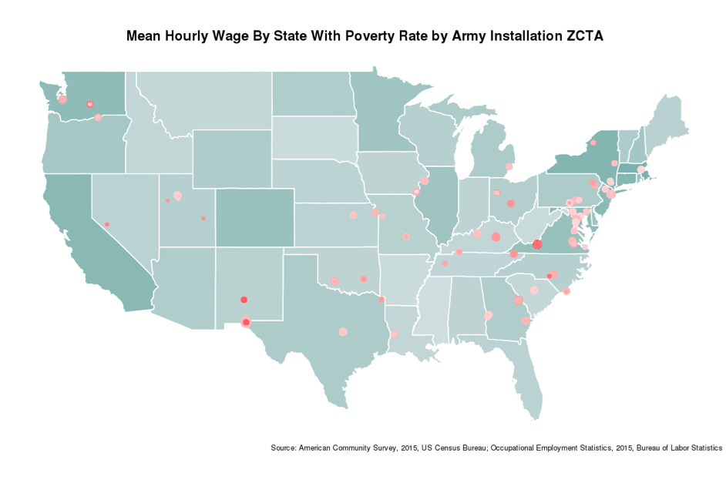
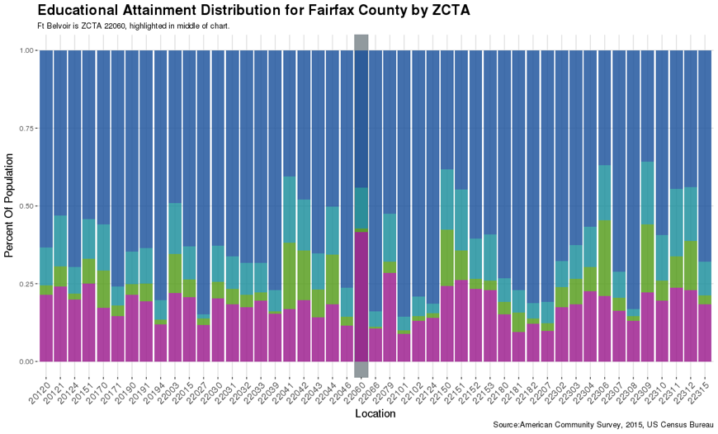
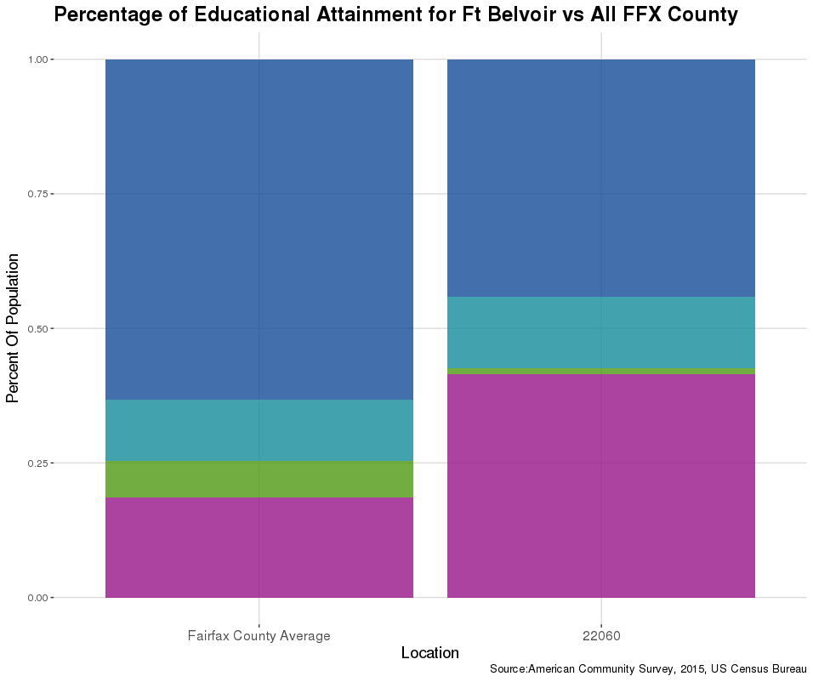
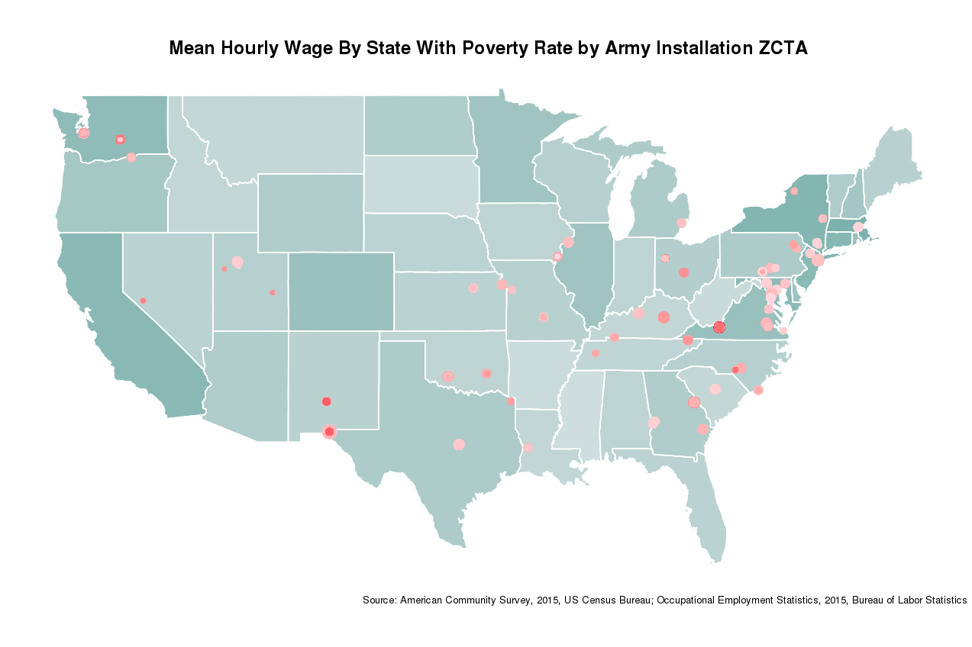
Embeddedness of Army Soldiers
Understand how embeddedness in a community affects performance of Army Soldiers.
Create profiles of communities surrounding Army Installations (sociodemographic, job/educational opportunities, local government and community services)
Sponsor – Joel Thurston and Nathaniel Ratcliff, U.S. Army Research Institute for the Social and Behavioral Sciences

Slide 23
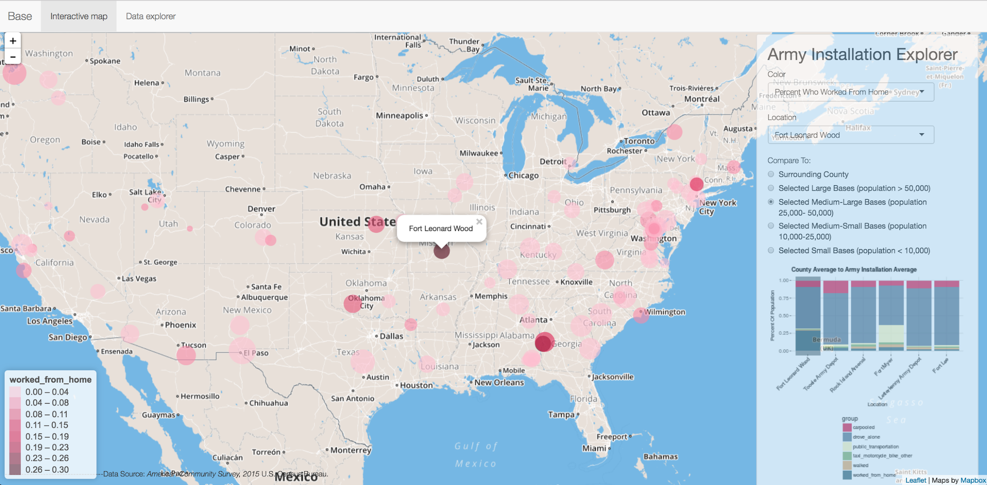
Army Installation Dashboard
https://aerogers.shinyapps.io/ari_base_dash/

Slide 24
Community Profiles and Analysis
Data Discovery – identifying new sources of data
Exploratory data analysis using visualization tools
Clustering communities using unsupervised learning methods
Relate to measures of Soldier performance (training, courts martial, promotion schedules, etc.)

Slide 25
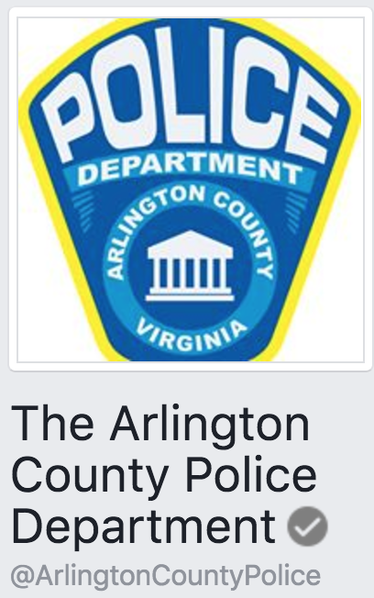

Alcohol-Related Crime Reduction Strategies for Restaurants and Nightlife in Arlington
PI: Gizem Korkmaz
Team: Aaron Schroeder and Sallie Keller
Sponsor: Corporal Dimitrios Mastoras, Niki Levy, Captain Bruce Benson Arlington County Police Department

Slide 26
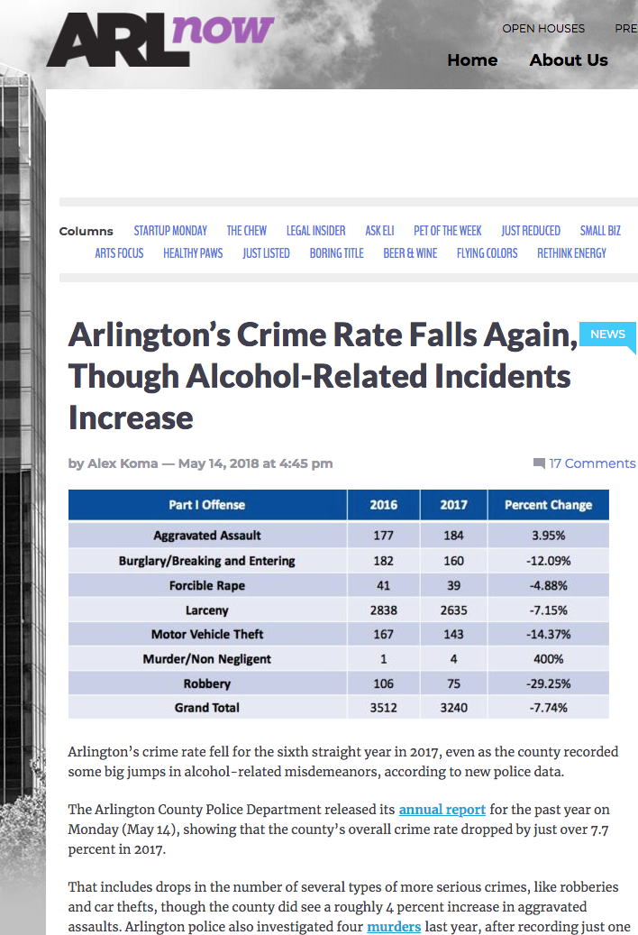
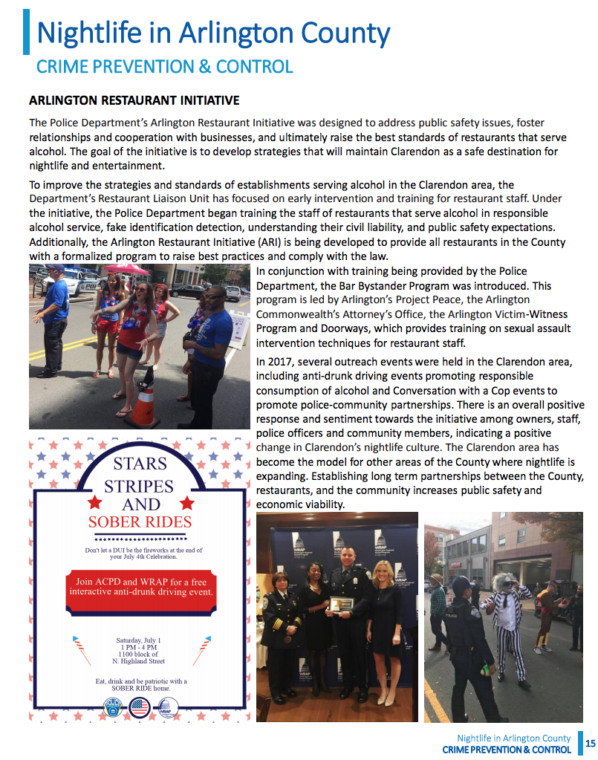

Slide 27
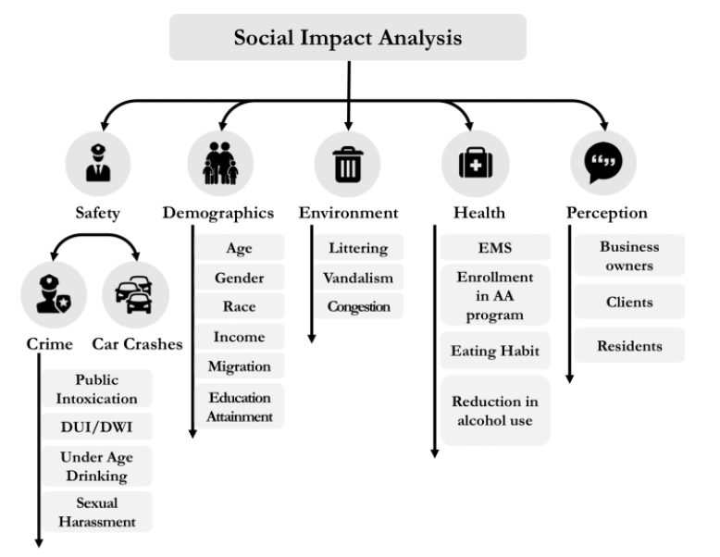
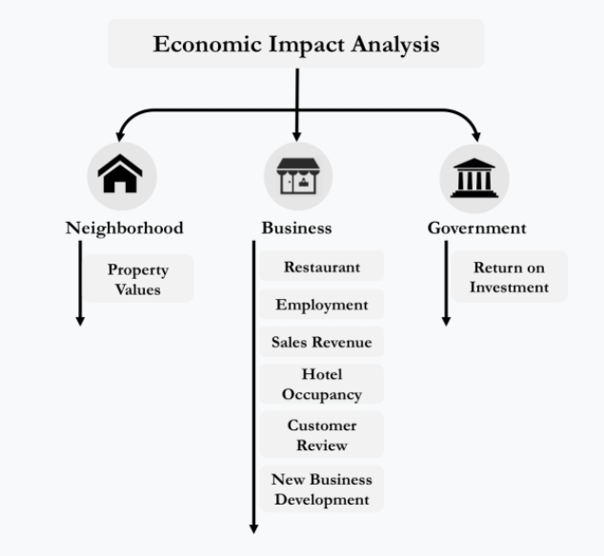
Research Questions
What is the social and economic impact of the Arlington Restaurant Initiative?
http://wenwenz.com/ARI/

Slide 28
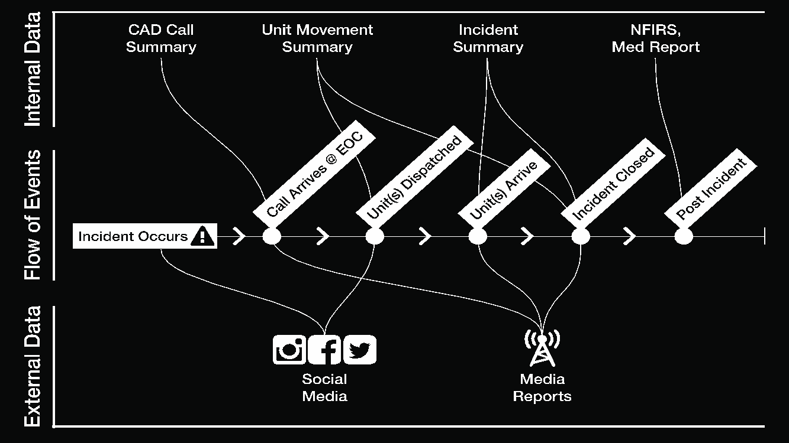

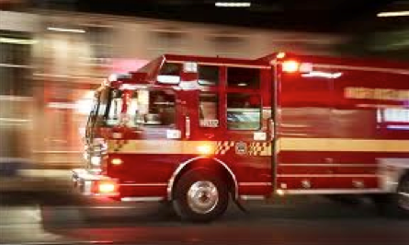
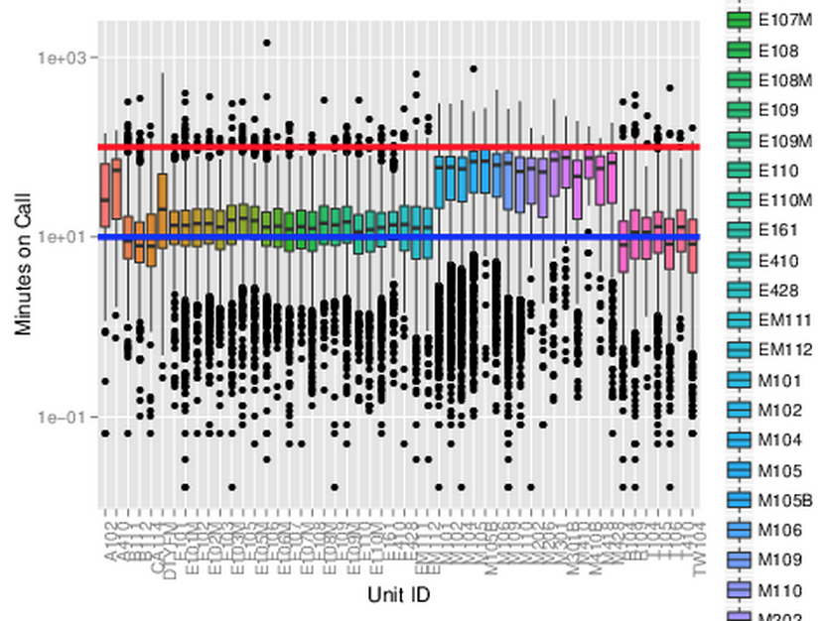
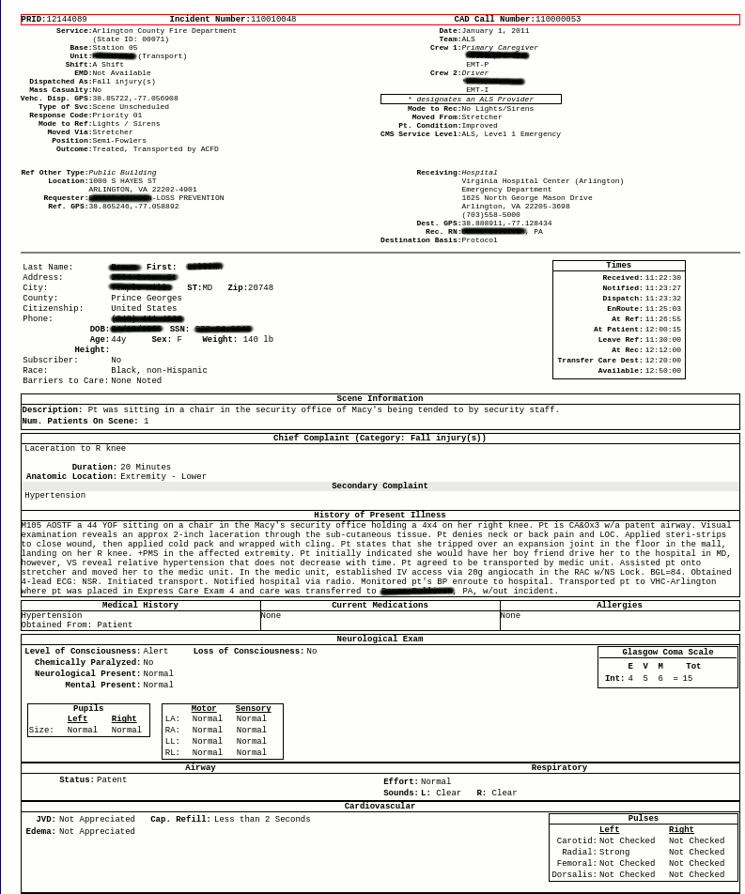

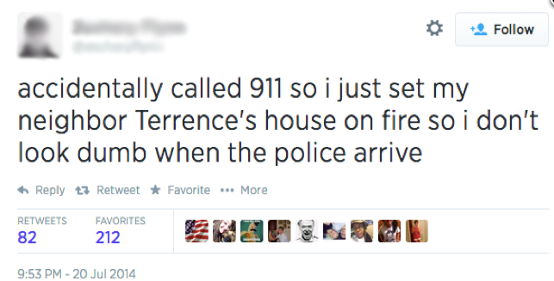
Project Goals & Deliverables
Exploratory Analysis of ACPD Crime Data
External data collection
social impact
return on investment
Statistical Analysis and Modeling
Data Dashboards
http://wenwenz.com/ARI/crime2.html

Slide 29
Data Linkage & Human Service Client Characterization Phase II
PI: Ian Crandell Team: Aaron Schroeder, Fangfang Lee
Sponsor: Department of Human Services, Arlington County

Slide 30



Project Overview
Arlington DHS has a 'no wrong door' philosophy meaning customers can sign-up for any DHS service from any DHS department
Data collected from multiple locations into different systems
Arlington DHS client data is managed in multiple systems
their own
those provided by the Commonwealth of Virginia
those provided by the Federal Government
Due to the myriad sources from which these data come, it’s not always clear when two systems are talking about the same person.
The project goal is to identify individuals that utilize different services.

Slide 31
Research Questions
The probabilistic algorithm in use, that of Fellegi and Sunter, does not handle missing data well. How can we improve on this?
How do we expand the work done linking a subset of the data sources to the rest of them?
Right now, we only link three different data streams.
This summer we will expand that work to more external systems.
How will our new deduplication procedure compare to the old ones, and what can we learn about service utilization patterns?
Who is using what and where?
What are the characteristics of these people? How many of them are there?

Slide 32
Project Goals & Deliverables
Combine deterministic, rule based linkage with probabilistic linkage.
Merge the current datasets with additional ones.
Describe the characteristics of people who use DHS’s services.
This will involve tabulation and simple predictive modeling.
Time permitting, we will explore machine learning approaches.

Slide 33
Arlington Equity Composite Indicators
PI: Vicki Lancaster Team: Stephanie Shipp, Brian Goode, Josh Goldstein
Sponsor: Community Progress Network

Slide 34

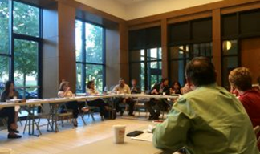
Project Overview
Formed in late 2017, CPN is an Arlington coalition of 30+ government agencies, nonprofits, business leaders, elected officials, and research institutions. CPN grew out of the Citi Foundation Community Progress Makers Fund grant awarded to the Arlington Partnership for Affordable Housing (APAH) in 2016.
The grant allowed APAH to build and preserve more affordable housing and mobilize a brain trust of community leaders to address inequality and inclusion (CPN).
The goal of CPN is to:
•Break down the silos between nonprofits
•Identify the issues facing Arlington's most vulnerable citizens
•Educate & engage the public, mobilize advocates
•Provide data-driven solutions

Slide 35
This is where DSPG comes in…
DATA-DRIVEN SOLUTIONS
What data summaries (for example, composite indicators, visualizations…) are needed to inform and evaluate policies?
What data summaries are needed to engage the public?
Can we construct composite indicators that would help Arlington develop a more equitable community?
What are other communities doing?

Slide 36
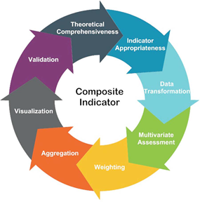
What is expected in this project…
literature review & web search to be presented to CPN
discovery of data sources for the composite indicators that aligns with the literature review and web search and CPN recommendations.
construction of at least two composite indicators with estimates of their statistical properties
presentation to CPN of baseline estimates of the composite indicators of equity & recommendations

Slide 37
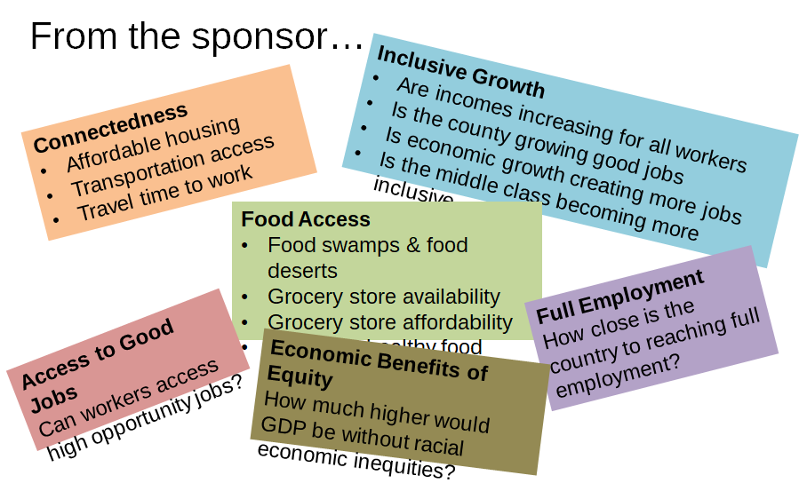

Slide 38

Creating Community-Scapes for Roanoke Valley and Allegheny Valley Regions of Virginia
PI: Stephanie Shipp
Team: Vicki Lancaster and Josh Goldstein
Sponsor: Wayne Strickland, Roanoke Valley Alleghany Regional Commission

Slide 39
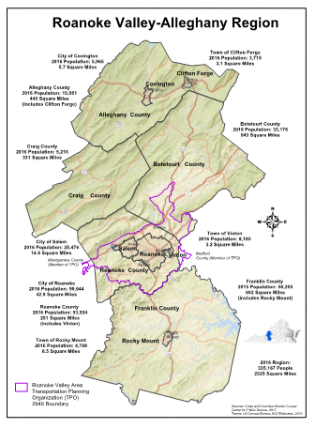
Project Overview
Community-scapes – create indicators at the sub-county or sub-city level by geographies of interest to the sponsor, e.g. not just Census Tracts but High School attendance areas, neighborhoods, quadrants of a city, etc.
Contribute to developing the science and methods of creating community-scapes indicators at sub-county/sub-city levels
Notes:
Our cities and counties are composed of many diverse neighborhoods, each with its own characteristics, needs, and desires. However many of our traditional statistics only allow us to view a city of county as a whole, not by geographies of interest.
In this project, you will contribute to developing the science and methods to create community-scapes indicators at sub-county/sub-city levels that are helpful to support local government leaders, community stakeholders, and Cooperative Extension professionals.
The Roanoke-Allegheny Valley region is composed of 5 counties and 3 cities. The areas has a mix of urban and rural areas and a diverse set of needs ranging from matching workforce development to jobs, maintaining health of the communities at the individual and environmental area.

Slide 40
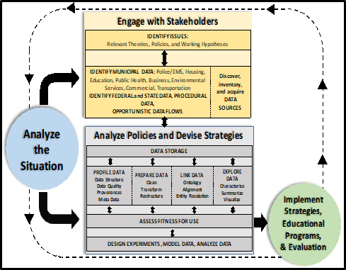
Developing Community-level Data-driven Insights
Data Discovery – identifying all types of data
Learning about synthetic population technology
Geocoding housing units and locations of interest
Creating composite Indicators,
e.g. vulnerability, access to healthy food, entrepreneurial quality index, and others
Exploring the data using visualization tools
Notes:
You will learn some or all of the following skills.
To created these community-scapes, we have developed 5 data sciences innovations, by applying existing methods in new ways.
1.Discovering new sources of data – obtained from local administrative data and webscraping data such as access to food and physical activity and combining these data with traditional data sources, such as federal surveys.
2.Creating socioeconomic profiles by statistically aligning American Community Survey data to new geographic boundaries using synthetic population technology.
3.Geocoding housing units, both owned and rented – and other locations of interest, such as parks, grocery stores, and fast food establishments.
4.Creating Composite Indicators by integrating data to assess vulnerability, or some other indicator of interest, at the neighborhood level
5.Exploring the data using different kinds of visualization tools

Slide 41
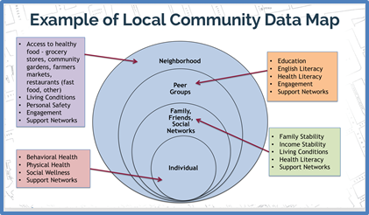
Research
Learn about the Roanoke-Allegheny Region:
•reading county and city websites and reports
•discovering and acquiring data
•conducting exploratory and descriptive analysis
•creating indicators of interest to the sponsor
Read and applying literature on composite indicators and synthetic population creation
Meet with sponsor 2 to 3 times
Collaborate with CPN/APAH DSPG team
Interact with other VT & Hollins teams conducting research in Roanoke City
Notes:
To get started, you will each learn about a 2-3 counties or cities in the area through reading, data discovery, profiling the data, conducting exploratory analysis, and creating indicators of interest to the sponsor.
You will meet:
with the sponsor 2 to 3 times, including at least one trip to Roanoke.
other VT & Hollins teams conducting research in Roanoke City
You will collaborate with the CPN/APAH team

Slide 42
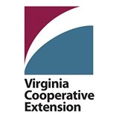
New Data Sources for Virginia Cooperative Extension Community Profiles
PI: Aaron Schroeder
Team: Brian Goode, Stephanie Shipp
Sponsor: Michael Lambur, Associate Director, Program Development, Virginia Cooperative Extension Service

Slide 43
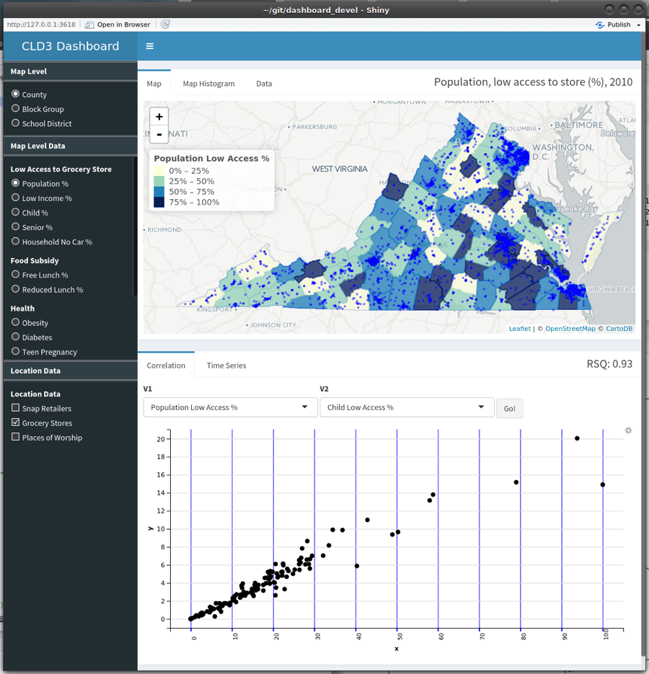
Project Overview
VCE District Planning includes an process of Community Profiling
SDAL is currently working with VCE to develop a Dashboard that will allow for a deeper level of analysis than is currently conducted, including:
Location (Place)-Level Data (Places of Worship, SNAP Providers, Social Service Locations)
Sub-County-Level Data (Block Groups, Water Districts, School Boundaries)
Tools for quick descriptive analysis (Maps, Time-Series, Scatterplots

Slide 44
Project Goal(s) / Research Questions
Discover possible sub-county data sources for use by VCE in creating community profiles, including:
Radon Levels
Active Coal Mine Locations
Water Quality (Rivers)
Water Quality (Treatment Plants)
Soil Status Quality
Profile discovered data sources quality, structure, provenance and metadata
Determine necessary transformations for data re-purposing and overall data source fitness to support VCE goals
Incorporate new data into dashboard; create new dashboard tools

Slide 45
Arlington Equity Composite Indicators
PI: Vicki Lancaster
Team: Stephanie Shipp, Josh Goldstein and Brian Goode
Sponsor: Nathanial Root, Jose Quinonez, and Cheryl Ramp Community Progress Network

Slide 46
Research Questions
The following questions will help direct the data discovery process – needs assessment for various populations:
What childcare services are available to low income residents for children ages 0-5 years?
What summer childcare services are there for low income families?
What do low income middle school children go after school, what programs are available to them?
What library services would better serve the elderly and immigrant populations?

Slide 47
Fitness of VDSS Administrative Data Sources to Support Household and Family Classification
PI: Brian J. Goode Team: Aaron Schroeder
Sponsor: Jeff Price, Director of Research and Planning, Virginia Department of Social Services

Slide 48
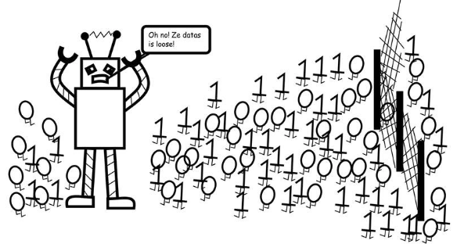
VDSS - VA Dept. of Social Services
Project Need: Accurately defining households and families can be critical to making informed social service public policy decisions
Being able to accurately derive these classifications using already existing administrative records would preclude the need for additional resources to be allocated toward additional data collection activities.

Slide 49
VDSS - VA Dept. of Social Services
Project Goal: Determine the fitness of selected VDSS administrative data record systems for accurately deriving household and family classifications.
Why you should work on this: You will get a deep-dive into data management, classification algorithms, and their evaluation.

Slide 50
Work Flow
Problem Definition
work with VDSS representatives and conduct literature review to best define the issue of household and family definition in social service policy making and social science research
Data Profiling, Preparation and Exploration
conduct analyses of Data Structure, Data Quality, Data Provenance and Metadata
conduct data cleaning, transformation and restructuring as required
create assessment of data source fitness for supporting the accurate definition of households and families
Data Discovery
conduct process of discovery, as necessary, of additional data sources that, when used in conjunction with OASIS and/or VaCMS data may support a more accurate definition of households and families.
Metric Creation and Validation
create and assess the accuracy and potential utility of new household and family definitions supported by the OASIS and VaCMS (and potentially other) data systems.

Slide 51
UMFS - United Methodist Foster Services
PI: Brian J. Goode Team: Josh Goldstein
Sponsor: Nancy Campos, Evaluation Specialist, United Methodist Foster Services

Slide 52

UMFS - United Methodist Foster Services
@SDAL - Brian J. Goode, Josh Goldstein;
@UMFS: Nancy Campos, evaluation specialist.
Project Goal: Identify potential families to target for recruitment to become foster parents to reduce disruptions.
Why you should work on this: It is the nexus of a very difficult problem with a very motivated and engaging sponsor. Also, May is national Foster Care month!
[source] https://umfs.org

Slide 53
Data Sources
Recruitment Efforts
Demographics - should be in SalesForce
Inquiry
Phone Screening
Application (SalesForce); Referrals; E-mail; Phone Screening Results
Orientation / Mutual Assessment
0/1 - Family signs up for training (when; how long); mutual assessment results ???
Training
Class materials / evaluations.
Feedback Meeting
Weekly Follow-ups?
Home Study
Adjudication
Home Study Narrative
Opening Meeting / Approval
Recommendations on Child Family Can Accept - this can highly impact the above - and possibly subject to external factors - e.g., emergency placements
Successful Foster Care

Slide 54
Next Steps: Task List / Breakdown
Task 1. Establish a set of baseline measures for proximity to core values.
Follow up with UMFS on existing questionnaires / applications
Task 2. Identify the process for decision making / inflow of foster children.
Start to build model of timelines for foster families (interactions with UMFS)
Task 3. Alternative Recruitment / Targeting Efforts
Why based on neighborhood / zip code?
How about social networks? Research shows that foster families are more successful when someone related to them is also a foster family and / or there is substantial support.
Data sources to identify geospatial and non-geospatial proximities of candidates not yet in the foster system.
Task 3. Continue literature survey - learn as much as possible.

Slide 55
Now tell us which projects you’d like to work on this summer!

Slide 56
Tips & Instructions
Read the ‘Project Descriptions’ in the Google Drive Shared Folder
Talk to Project PI’s & Co-PI’s for more information
Send an email to Gizem Korkmaz (gkorkmaz@vt.edu) & Aaron Schroeder (aschroed@vt.edu) indicating:
- top 4 project choices
- level of R (and other language) skills (none/low/medium/high)
by 9AM tomorrow, sooner the better!
Talk to Gizem & Aaron for suggestions, Offices 3-010 & 3-030
You will be assigned projects and mentors tomorrow!

Slide 57
Projects
New Metrics for Assessing Virginia Tech Student Acquisition, Progression & Success VT Office of the Executive Vice President and Provost
National-Level Projects
National Science Foundation (NSF):
Measuring the Scope and Impact of Open Source Software Innovation
Measuring Business Innovation Using Non-Traditional Data Sources
Identifying STEM Pathways
Army Research Institute (ARI): Community Embeddedness of Army Soldiers
Local Community Projects
ACPD - Alcohol-Related Crime Reduction Strategies for Restaurants and Nightlife in Arlington
DHS - Data Linkage & Characterization Phase II, Department of Human Services
CPN - Arlington Equity Composite Indicators, Community Progress Network
Roanoke - Create Community-Scapes for City of Roanoke and Allegheny Valley Regions in Virginia
State-Level Projects
VCE - New Data Sources for Virginia Cooperative Extension Community Profiles
VDSS - Fitness of VDSS Administrative Data Sources
UMFS - Foster Parent Recruitment and Disruptions in Foster Care

